Slide 1
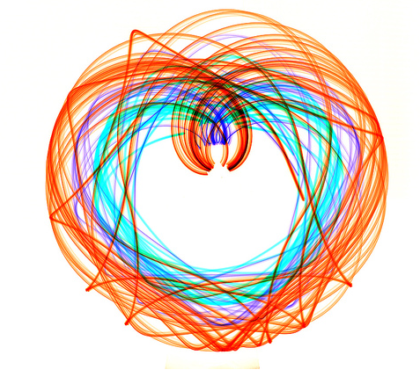
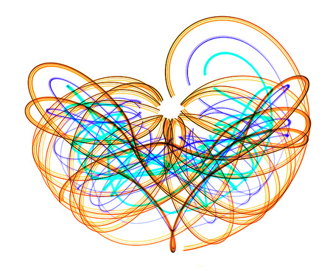
Nonlinear Mechanics and Chaos
12
Jen-Hao Yeh

Slide 2
Linear | Nonlinear
easy | hard
Uncommon | common
analytical | numerical
Superposition principle
 | Chaos

Slide 3
Nonlinear
Chaotic
Linear

Slide 4
Driven, Damped Pendulum (DDP)
We expect something interesting to happen as γ → 1,
i.e. the driving force becomes comparable to the weight

Slide 5

A Route to Chaos

Slide 6

NDSolve in Mathematica
Download Mathematica for free:
https://terpware.umd.edu/Windows/Package/2032

Slide 7
Driven, Damped Pendulum (DDP)
For all following plots:
Period = 2π/ω = 1

Slide 8
Small Oscillations of the Driven, Damped Pendulum
γ << 1 will give small oscillations
γ = 0.2
φ(t)
t
Calculated with Mathematica NDSolve
After the initial transient, the
solution looks like
Periodic “attractor”
Fig. 12.2

Slide 9
Small Oscillations of the Driven, Damped Pendulum
γ << 1 will give small oscillations
The motion approaches a unique periodic attractor
  independent of initial conditions
The motion is sinusoidal with the same frequency as the drive

Slide 10
Moderate Driving Force Oscillations of the Driven, Damped Pendulum
γ < 1 and the nonlinearity becomes significant…
Try
This solution gives from the φ³ term:
Since there is no cos(3ωt) on the RHS, it must be that
all develop a cos(3ωt) time dependence. Hence we expect:
We expect to see a third harmonic as the driving force grows

Slide 11
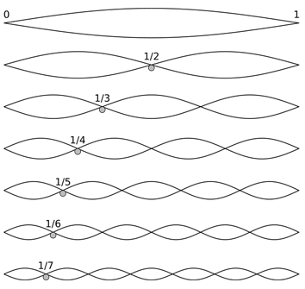
Harmonics

Slide 12
Stronger Driving: The Nonlinearity Distorts the cos(ωt)
φ(t)
γ = 0.9
φ(t)
cos(ωt)
t
t
-cos(3ωt)
The motion is periodic, but …
The third harmonic distorts the simple
Fig. 12.3

Slide 13
Even Stronger Driving: Complicated Transients – then Periodic!
After a wild initial transient, the motion becomes periodic
φ(t)
γ = 1.06
t
After careful analysis of the long-term motion, it is found to be periodic
with the same period as the driving force
Fig. 12.4

Slide 14
Slightly Stronger Driving: Period Doubling
After a wilder initial transient, the motion becomes periodic, but period 2!
φ(t)
γ = 1.073
t
The long-term motion is TWICE the period of the driving force!
A SUB-Harmonic has appeared
Fig. 12.5

Slide 15

Harmonics
Sub-harmonic

Slide 16
Slightly Stronger Driving: Period 3
The period-2 behavior still has a strong period-1 component
Increase the driving force slightly and we have a very strong period-3 component
φ(t)
γ = 1.077
Period 3
t
Fig. 12.6

Slide 17
Multiple Attractors
The linear oscillator has a single attractor for a given set of initial conditions
For the driven damped pendulum:
Different initial conditions result in different long-term behavior (attractors)
φ(t)
γ = 1.077
Period 3
t
Period 2
Fig. 12.7

Slide 18
Period Doubling Cascade
φ(t)
φ(t)
Early-time motion
γ = 1.06
t
Close-up of steady-state
motion
Period 1
t
γ = 1.078
Period 2
γ = 1.081
Period 4
γ = 1.0826
Period 8
Fig. 12.8

Slide 19
Period Doubling Cascade
Period doubling continues in a sequence of ever-closer values of γ
Such period-doubling cascades are seen in many nonlinear systems
Their form is essentially the same in all systems – it is “universal”
Sub-harmonic frequency spectrum
Driven Diode experiment
F₀ cos(ωt)
ω/2

Slide 20

Period Doubling Cascade
γ = 1.06
γ = 1.078
γ = 1.081
γ = 1.0826

Slide 21
‘Bifurcation Points’ in the Period Doubling Cascade
Driven Damped Pendulum
n period γ_{n} interval (γ_{n+1}-γ_{n})
1 1 → 2 1.0663
0.0130
2 2 → 4 1.0793
0.0028
3 4 → 8 1.0821
0.0006
4 8 → 16 1.0827
The spacing between consecutive bifurcation points grows smaller at a steady rate:
‘≈’ → ‘=’ as n → ∞
δ = 4.6692016 is called the Feigenbaum number
The limiting value as n → ∞ is γ_{c} = 1.0829. Beyond that is … chaos!

Slide 22

Period infinity

Slide 23
Chaos!
φ(t)
γ = 1.105
t
The pendulum is “trying” to oscillate at the driving frequency, but
the motion remains erratic for all time
Fig. 12.10

Slide 24
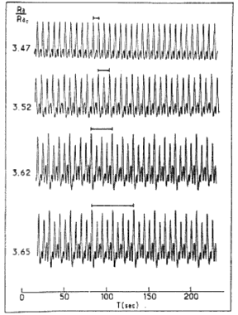
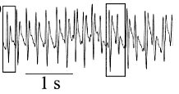
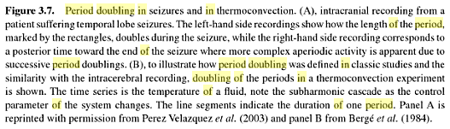
Period Doubling Cascade
Period doubling continues in a sequence of ever-closer values of γ
Such period-doubling cascades are seen in many nonlinear systems
Their form is essentially the same in all systems – it is “universal”
The Brain-behaviour Continuum: The Subtle Transition Between Sanity and Insanity
By Jose Luis. Perez Velazquez
Fig. 12.9, Taylor

Slide 25
Chaos
Nonperiodic
Sensitivity to initial conditions

Slide 26
Sensitivity of the Motion to Initial Conditions
Start the motion of two identical pendulums with slightly different initial conditions
Does their motion converge to the same attractor?
Does it instead diverge quickly?
Two pendulums
are given different initial conditions
Follow their evolution and calculate
For a linear oscillator
Long-term
attractor
Transient
behavior
The initial conditions affect the transient behavior, the long-term attractor is the same
Hence
Thus the trajectories will converge after the transients die out

Slide 27
Convergence of Trajectories in Linear Motion
Take the logarithm to magnify small differences..
Plotting log₁₀[|Δφ(t)|] vs. t should be a straight line of slope –β,
plus some wiggles from the cos(ω₁t – δ₁) term
Note that log₁₀[x] = log₁₀[e] ln[x]

Slide 28
Convergence of Trajectories in Linear Motion
Log₁₀[|Δφ(t)|]
t
γ = 0.1
Δφ(0) = 0.1 Radians
The trajectories converge quickly for the small driving force (~ linear) case
This shows that the linear oscillator is essentially insensitive to its initial conditions!
Fig. 12.11

Slide 29
Convergence of Trajectories in Period-2 Motion
Log₁₀[|Δφ(t)|]
t
γ = 1.07
Δφ(0) = 0.1 Radians
The trajectories converge more slowly, but still converge
Fig. 12.12

Slide 30
Divergence of Trajectories in Chaotic Motion
γ = 1.105
Log₁₀[|Δφ(t)|]
Δφ(0) = 0.0001 Radians
t
If the motion remains bounded, as it does
in this case, then Δφ can never exceed 2π.
Hence this plot will saturate
The trajectories diverge, even when very close initially
Δφ(16) ~ π, so there is essentially complete loss of correlation between the pendulums
Extreme Sensitivity to Initial Conditions
Fig. 12.13

Slide 31
The Lyapunov Exponent
λ = Lyapunov exponent
λ < 0: periodic motion in the long term
λ > 0: chaotic motion

Slide 32
Chaos
Nonperiodic
Sensitivity to initial conditions
Linear | Nonlinear | Chaos
Drive period | Period doubling | Nonperiodic
λ < 0 | λ < 0 | λ > 0

Slide 33
What Happens if we Increase the Driving Force Further?
Does the chaos become more intense?
Δφ(0) = 0.001 Radians
φ(t)
γ = 1.13
Log₁₀[|Δφ(t)|]
t
t
Period 3 motion re-appears!
Fig. 12.14

Slide 34
What Happens if we Increase the Driving Force Further?
Does the chaos re-appear?
Δφ(0) = 0.001 Radians
φ(t)
γ = 1.503
t
Log₁₀[|Δφ(t)|]
t
Chaotic motion re-appears!
This is a kind of ‘rolling’ chaotic motion
Fig. 12.15

Slide 35
Divergence of Two Nearby Initial Conditions
for Rolling Chaotic Motion
φ(t)
γ = 1.503
t
Δφ(0) = 0.001 Radians
Chaotic motion is always associated with extreme sensitivity to initial conditions
Periodic and chaotic motion occur in narrow intervals of γ
Fig. 12.16

Slide 36
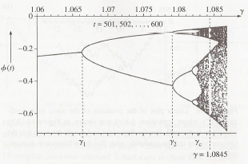
Bifurcation Diagram
Used to visualize the behavior as a function of driving amplitude γ
Choose a value of γ
Solve for φ(t), and plot a periodic sampling of the function
  t₀ chosen so that the attractor behavior is achieved
Move on to the next value of γ
1.0663
1.0793
Fig. 12.17

Slide 37
Construction of the Bifurcation Diagram
φ(t)
γ = 1.06
Period 1
t
γ = 1.078
Period 2
γ = 1.081
Period 4
Period 6
window
γ = 1.0826
Period 8

Slide 38
The Rolling Motion Renders the Bifurcation Diagram Useless
φ(t)
γ = 1.503
t
Δφ(0) = 0.001 Radians
As an alternative, plot

Slide 39
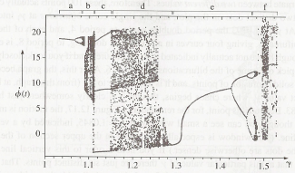
Bifurcation Diagram Over a Broad Range of γ
Previous diagram
range
Period-1 followed
by period doubling
bifurcation
Mostly chaos
Mostly chaos
Mostly chaos
Period-3
Rolling Motion
(next slide)

Slide 40
Period-1 Rolling Motion at γ = 1.4
γ = 1.4
t
φ(t)
t
Even though the pendulum is “rolling”, is periodic

Slide 41
An Alternative View: State Space Trajectory
Plot vs. with time as a parameter
φ(t)
t
γ = 0.6
periodic
attractor
start
First 20 cycles
Cycles 5 -20
Fig. 12.20, 12.21

Slide 42
An Alternative View: State Space Trajectory
Plot vs. with time as a parameter
γ = 0.6
start
periodic
attractor
First 20 cycles
Cycles 5 -20
The periodic attractor:
[ , ] is an ellipse
The state space point moves clockwise on the orbit
Fig. 12.22

Slide 43
State Space Trajectory for Period Doubling Cascade
γ = 1.078
γ = 1.081
Period-2
Period-4
Plotting cycles 20 to 60
Fig. 12.23

Slide 44
State Space Trajectory for Chaos
γ = 1.105
Cycles 14 - 21
Cycles 14 - 94
The orbit has not repeated itself…

Slide 45
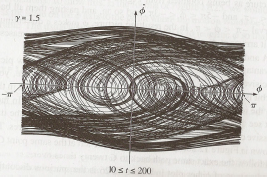
State Space Trajectory for Chaos
= 1.5
β = ω₀/8
Chaotic rolling motion
Mapped into the interval –π < φ < π
Cycles 10 – 200
This plot is still quite messy. There’s got to be a better way to visualize the motion …

Slide 46
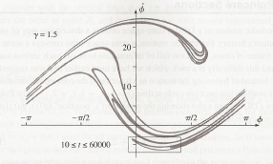
The Poincaré Section
Similar to the bifurcation diagram, look at a sub-set of the data
Solve for φ(t), and construct the state-space orbit
Plot a periodic sampling of the orbit
  with t₀ chosen so that the attractor behavior is achieved
= 1.5
β = ω₀/8
Samples 10 – 60,000
Enlarged on the next slide

Slide 47
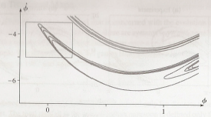
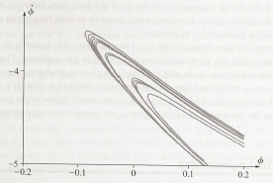
The Poincaré Section is a Fractal
The Poincaré section is a much more
elegant way to represent chaotic
motion

Slide 48
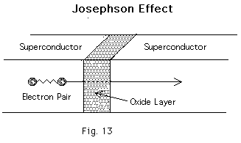


The Superconducting Josephson Junction as a Driven Damped Pendulum
1
2
I
(Tunnel barrier)
The Josephson
Equations
φ =φ₂−φ₁ = phase difference of SC wave-function across the junction

Slide 49
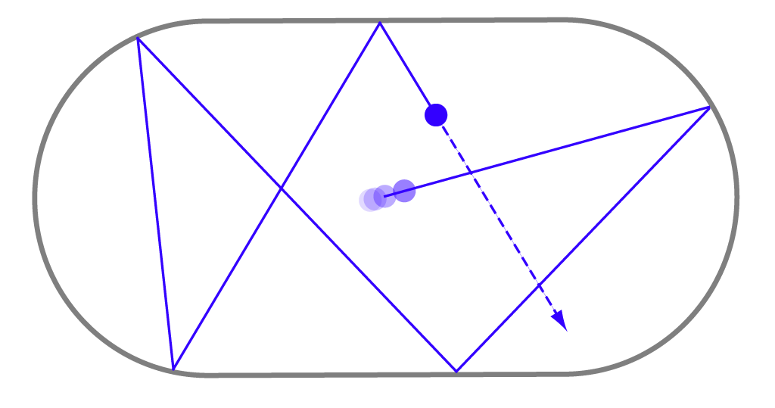
Chaos in Newtonian Billiards
Imagine a point-particle trapped in a 2D enclosure and making
elastic collisions with the walls
Describe the successive wall-collisions
with a “mapping function”
Linear Maps for “Integrable” systems !!
0
Non-Linear Maps for “Chaotic” systems !!
The “Chaos” arises due to the shape of the boundaries enclosing the system.
Computer animation of extreme sensitivity to initial conditions for the stadium billiard

